Slide 1

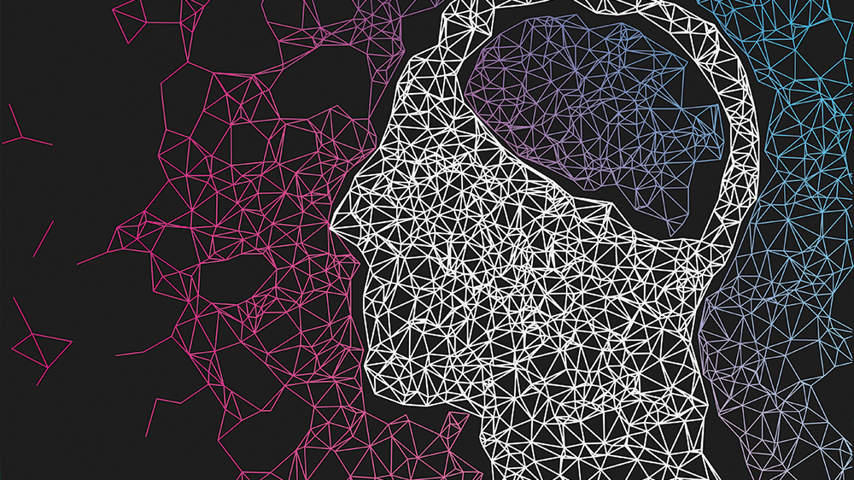
Study of Convolutional Neural Networks for Early Detection of Diabetic Retinopathy
Rafael Mosheyoff
Shoval Yehuda
Yosef Zoubi
Or Eliyahu

Slide 2
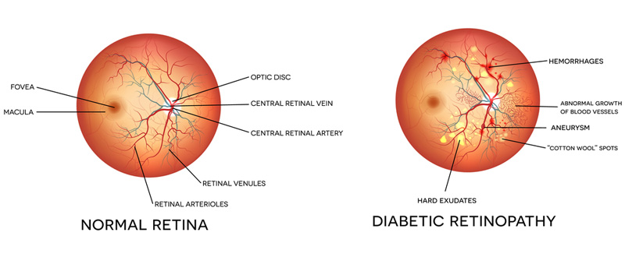
Problem
Diabetic retinopathy is an eye disease that affects the eyes of diabetics, it is the leading cause of blindness in the working-age
The current diagnosis process is long, an ophthalmologist classifies the images by hand
Computer machine learning technologies such as CNNs have emerged as an effective tool in medical image analysis for the detection and classification of DR in real-time.

Slide 3
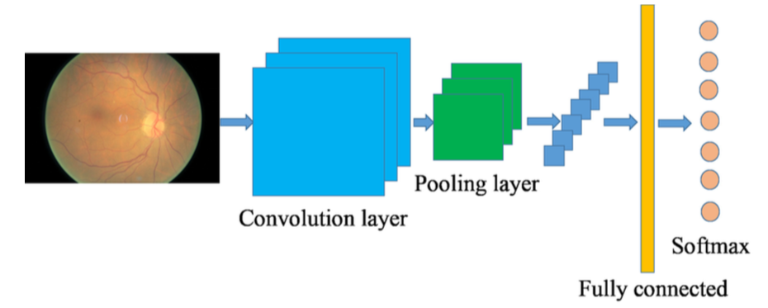
Introduction
During 2018, Rachel Cai had the opportunity to intern at the National Institutes of Health to study Convolutional Neural Networks for the early detection of diabetic retinopathy
In the study they adapt several CNNs for the classification of DR stages.

Slide 4
Convolutional Neural Network
CNN for DR Detection
special kind of multi-layer neural networks, designed to recognize visual patterns directly from pixel images with minimal preprocessing.

Slide 5
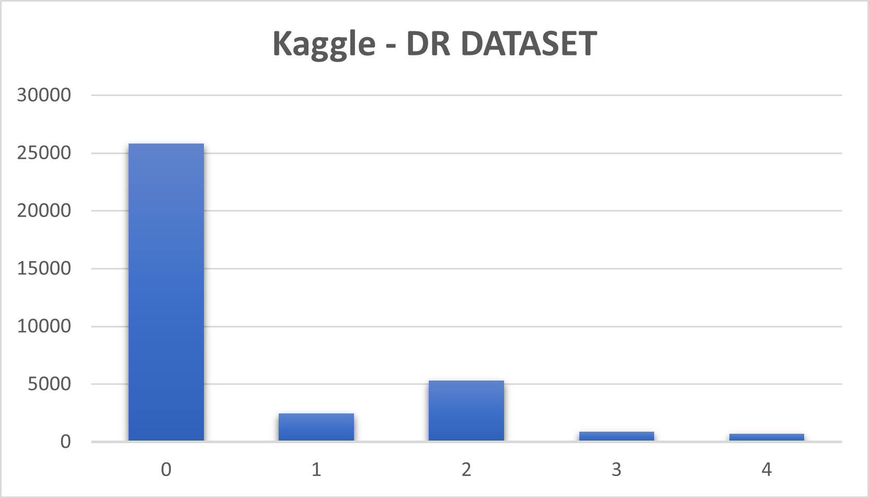
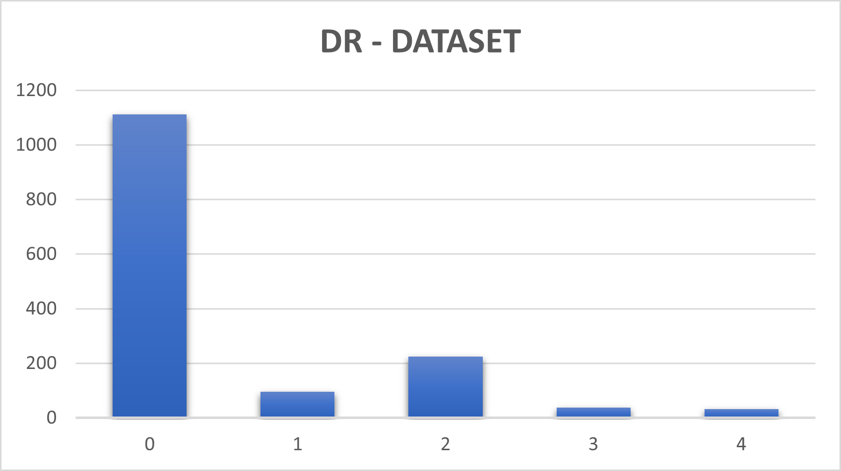
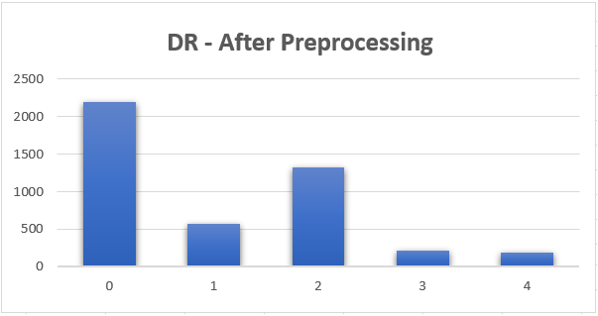
Datasets
Kaggle DR competition dataset Our main dataset is based on the Kaggle Diabetic Retinopathy Detection competition which was carried out in 2016. The main dataset contains 35,000 eye images with 5 stages of DR disease.
Row Labels | Count of image | Count
0 | 25810 | 73.48%
1 | 2443 | 6.95%
2 | 5292 | 15.07%
3 | 873 | 2.49%
4 | 708 | 2.02%
Grand Total | 35126 | 100%
Row Labels | Count of image | Count
0 | 1111 | 74.07%
1 | 96 | 6.40%
2 | 225 | 15.00%
3 | 37 | 2.47%
4 | 31 | 2.07%
Grand Total | 1500 | 100.00%
Row Labels | Count of image | Count
0 | 2196 | 48.74%
1 | 576 | 12.78%
2 | 1326 | 29.43%
3 | 222 | 4.93%
4 | 186 | 4.13%
Grand Total | 4506 | 100.00%

Slide 6
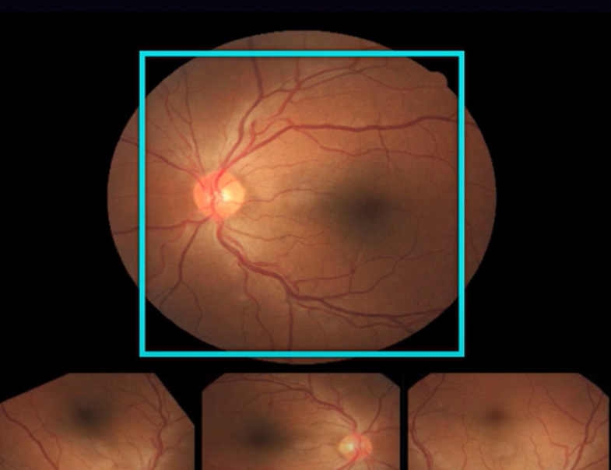
Preprocess the data
Transformation | Description
Rotation | Rotate 0-360 degrees
Flipping | Flip horizontally or vertically
Rescaling | Randomly scale with scaling factor between 1/1.6 and 1.6
Translation | Randomly shift between -10 and 10 pixels

Slide 7
Our Preprocessing
Transformation | Description | Label
Rotation | Rotate 90, 120, 180, 270 degrees | 1, 2, 3, 4
Flipping | Flip horizontally vertically | For all
Rescaling | Randomly scale with scaling factor between 1/1.6 and 1.6 (override the original) | For all
Remove Dark images | - (override the original) | For all

Slide 8
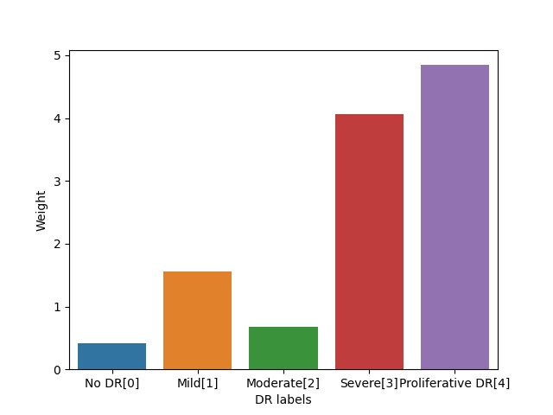
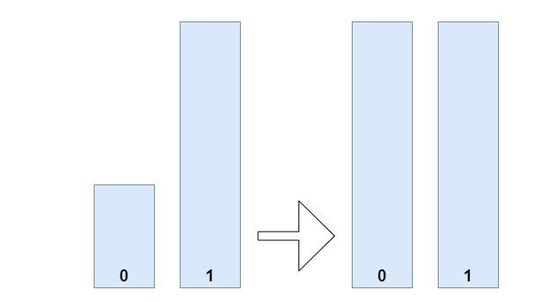
Stages of DR
There is a 5 class DR classification, ranging from 0 (No DR) to 5 (Proliferative DR).
Weights = n_samples/(n_classes*bins)
4506 / (5 * [2196 576 1326 222 186]) = [0.41038251 1.56458333 0.67963801 4.05945946 4.84516129]

Slide 9
Building the model
Convolutional Neural Network is a feed-forward neural network. It mainly consists of an input layer, many hidden layers and a final multi-label classification layer
An efficient way to build neural network architectures is to use classic networks, in our project we have used a pre-trained model “VGG” architecture and we add custom layers on top of it

Slide 10

What is VGG16 model
The VGG network architecture was introduced by Simonyan and Zisserman in 2014, Very Deep Convolutional Networks for Large Scale Image Recognition. The VGG network is characterized by its simplicity
Training Method | Accuracy | AUC
VGG Pretrained | 59% | 0.67
VGG From scratch | 52% | 0.46

Slide 11
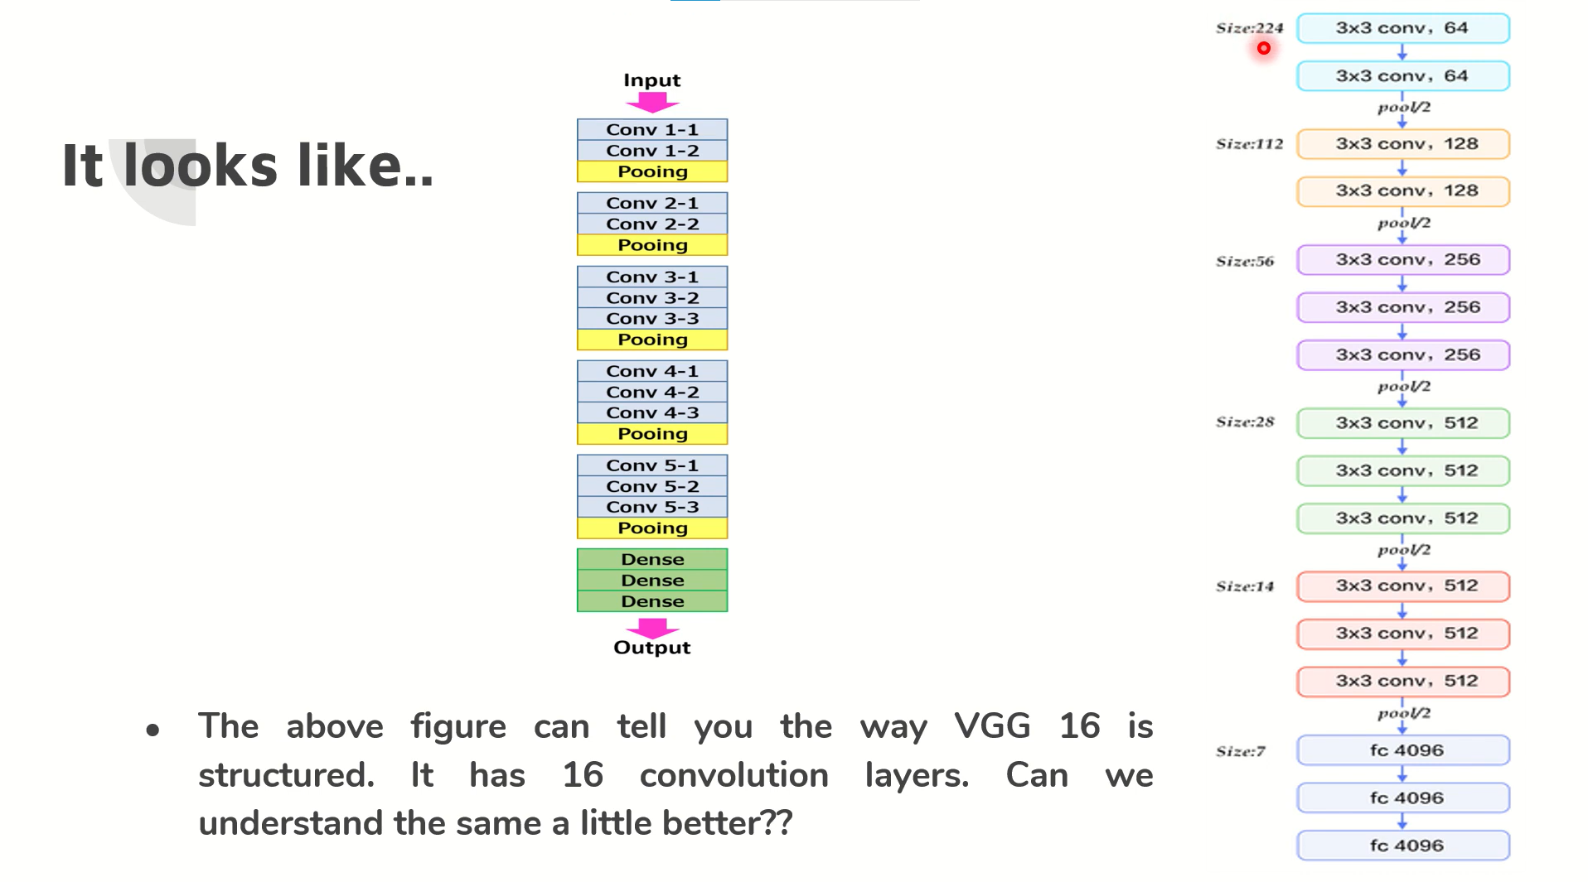
How does VGG16 looks like?

Slide 12
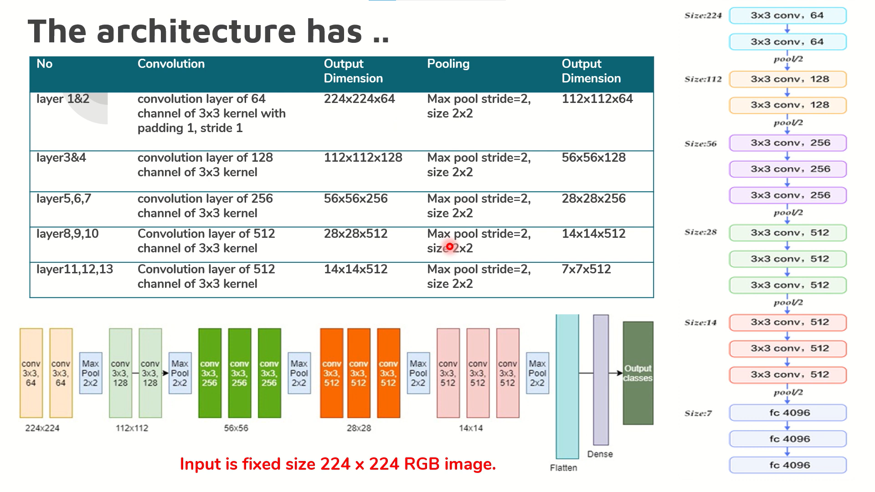
How does VGG16 work?

Slide 13
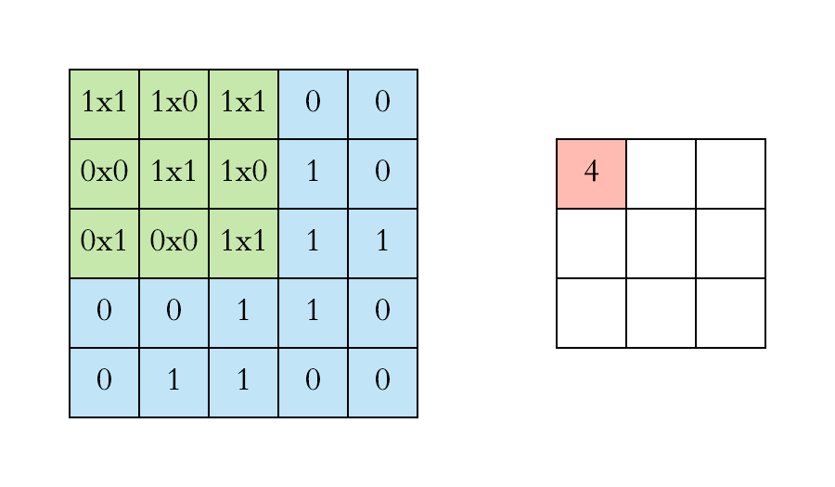
Convolution2D
Convolution is the first layer to extract features from an input image. Convolution preserves the relationship between pixels by learning image features using small squares of input data. It is a mathematical operation that takes two inputs such as image matrix and a filter or kernel.

Slide 14
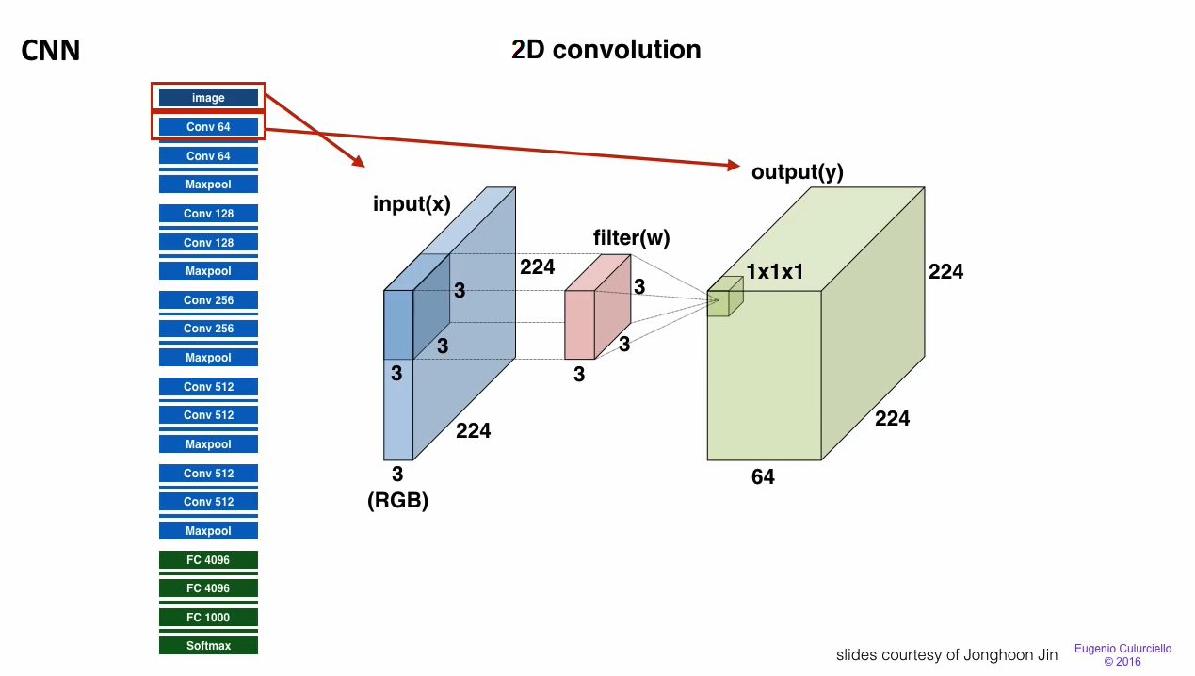

Slide 15
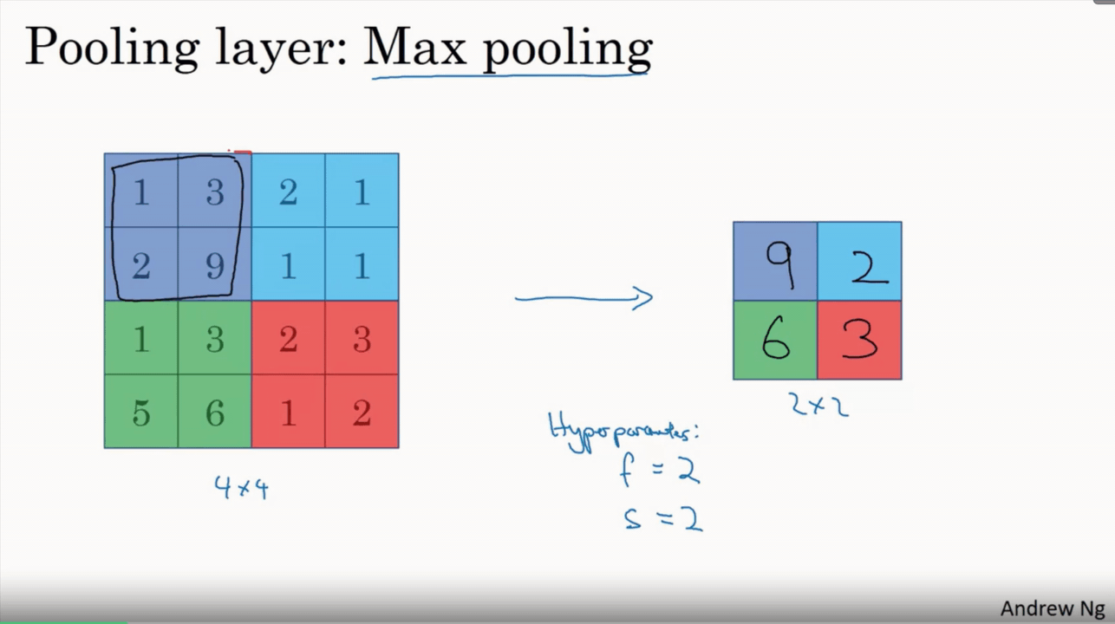
Max Pooling
Maximum pooling, or max pooling, is a pooling operation that calculates the maximum, or largest, value in each patch of each feature map.
The results are down sampled or pooled feature maps that highlight the most present feature in the patch.

Slide 16
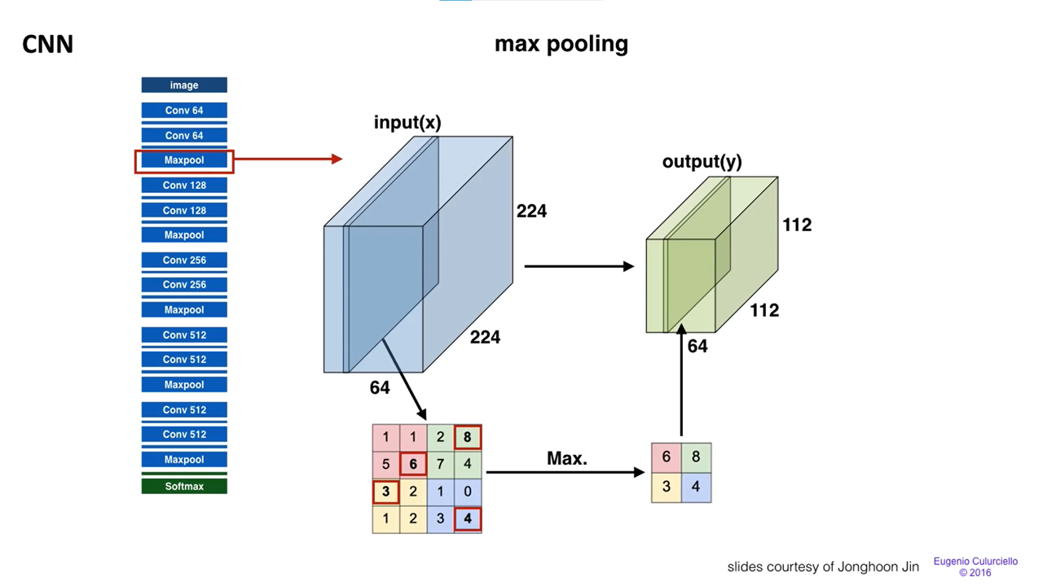

Slide 17

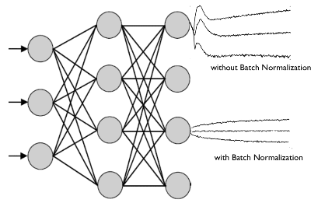



Batch normalization

Slide 18
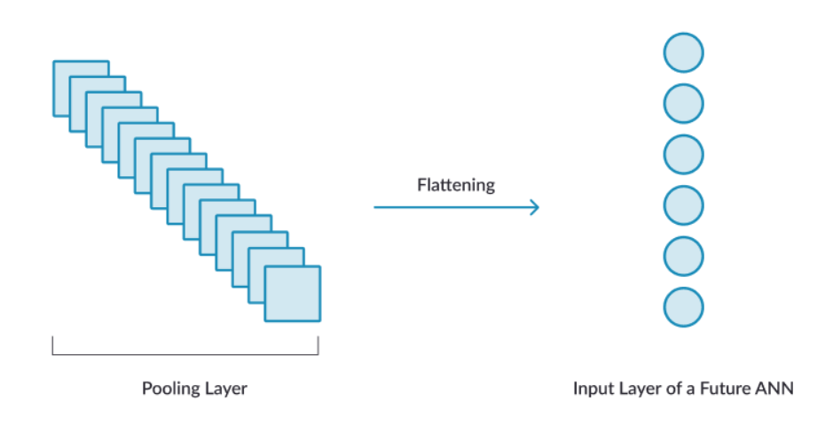

Flatten
Flattening is converting the data into a 1-dimensional array for inputting it to the next layer.
We flatten the output of the convolutional layers to create a single long feature vector. And it is connected to the final classification model, which is called a fully-connected layer.

Slide 19
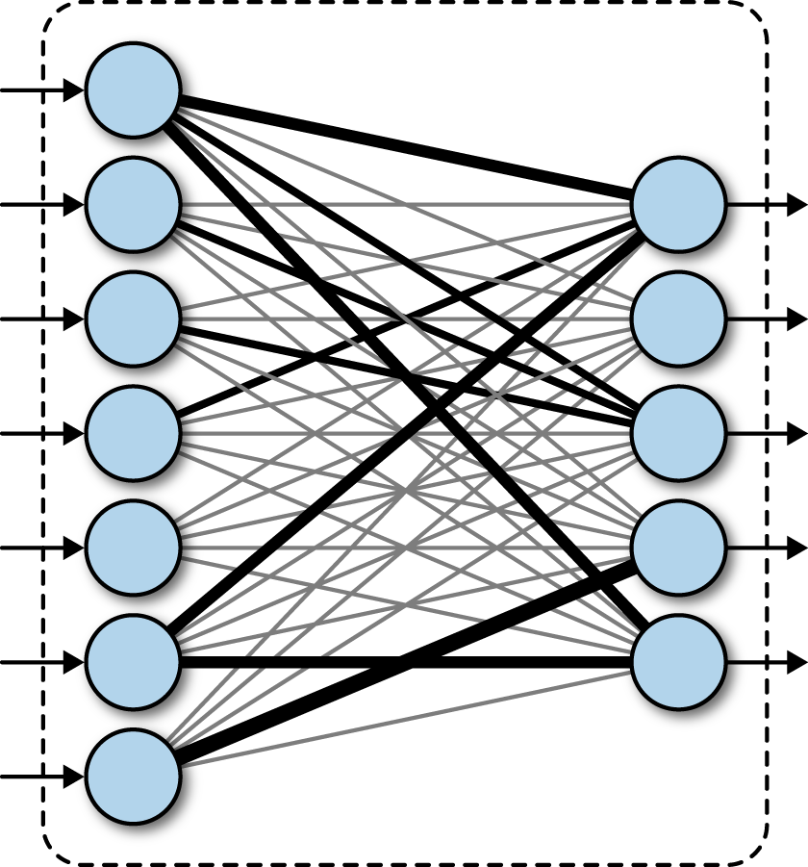
Fully Connected
After feature extraction we need to classify the data into various classes, this can be done using a fully connected (FC) neural network
Taking the inputs from the feature analysis and applies weights to predict the correct label.

Slide 20
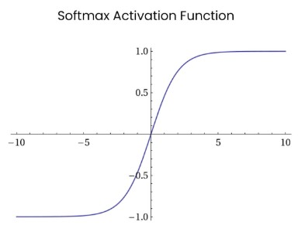
SoftMax layer
SoftMax activation is normally applied to the very last layer in a neural net. The reason why SoftMax is useful is because it converts the output of the last layer in your neural network into what is essentially a probability distribution.

Slide 21
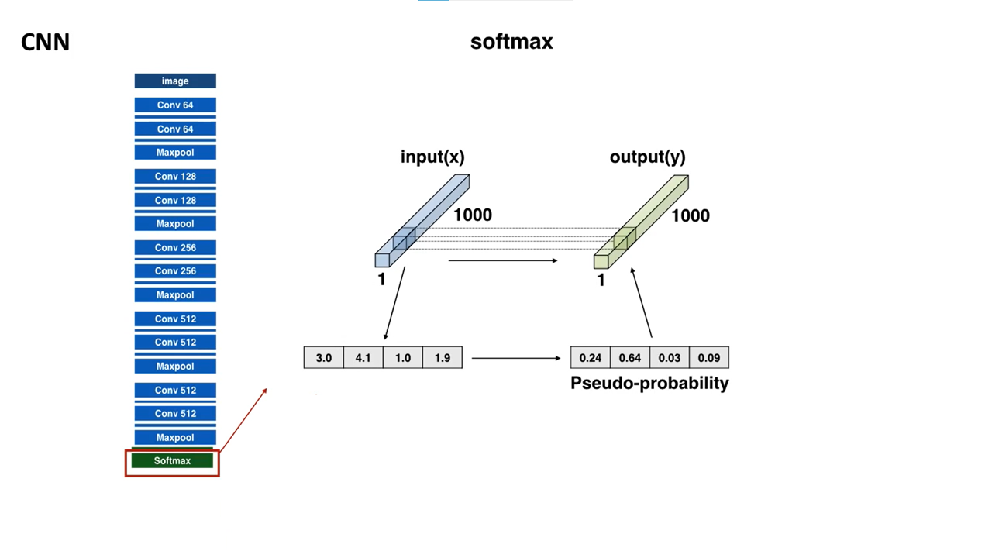

Slide 22
Model summary
VGG16
Custom layers with VGG16
Layer (type) | Output Shape | Param #
block1_conv1 (Conv2D) | (None, 224, 224, 64) | 1792
block1_conv2 (Conv2D) | (None, 224, 224, 64) | 36928
block1_pool (MaxPooling2D) | (None, 112, 112, 64) | 0
block2_conv1 (Conv2D) | (None, 112, 112, 128) | 73856
block2_conv2 (Conv2D) | (None, 112, 112, 128) | 147584
block2_pool (MaxPooling2D) | (None, 56, 56, 128) | 0
block3_conv1 (Conv2D) | (None, 56, 56, 256) | 295168
block3_conv2 (Conv2D) | (None, 56, 56, 256) | 590080
block3_conv3 (Conv2D) | (None, 56, 56, 256) | 590080
block3_pool (MaxPooling2D) | (None, 28, 28, 256) | 0
block4_conv1 (Conv2D) | (None, 28, 28, 512) | 1180160
block4_conv2 (Conv2D) | (None, 28, 28, 512) | 2359808
block4_conv3 (Conv2D) | (None, 28, 28, 512) | 2359808
block4_pool (MaxPooling2D) | (None, 14, 14, 512) | 0
block5_conv1 (Conv2D) | (None, 14, 14, 512) | 2359808
block5_conv2 (Conv2D) | (None, 14, 14, 512) | 2359808
block5_conv3 (Conv2D) | (None, 14, 14, 512) | 2359808
block5_pool (MaxPooling2D) | (None, 7, 7, 512) | 0
Layer (type) | Output Shape | Param #
input (InputLayer) | [(None, 224, 224, 3)] | 0
vgg16 (Model) | (None, 7, 7, 512) | 14714688
batch_normalization_1 (Batch | (None, 7, 7, 512) | 2048
flatten (Flatten) | (None, 25088) | 0
fc1 (Dense) | (None, 4096) | 102764544
fc2 (Dense) | (None, 4096) | 16781312
output (Dense) | (None, 5) | 20485
Total params: 134,283,077
Trainable params: 119,567,365
Non-trainable params: 14,715,712

Slide 23
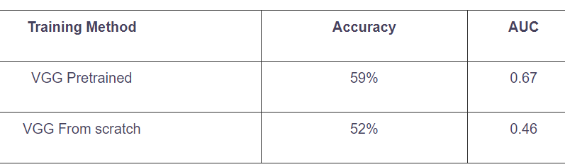
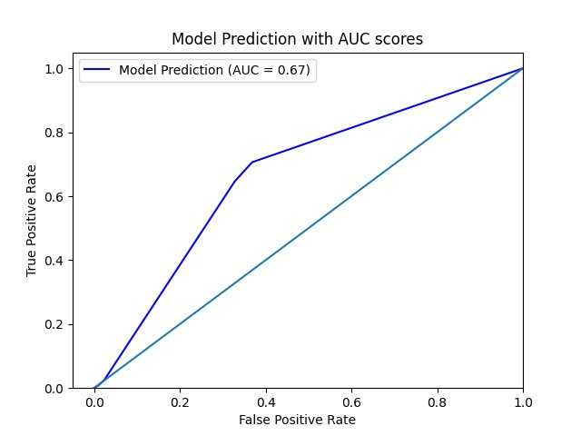
Training the model
Building and training a deep neural network such as VGG16 from scratch takes a lot of time, therefor we usually use the no-top-layer pretrained model and then add several layers of normalization and fully connected layer on the top. We will then retrain the final classification layer.

Slide 24
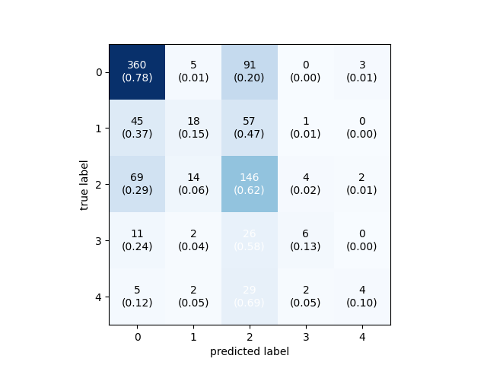
Confusion Matrix

Slide 25
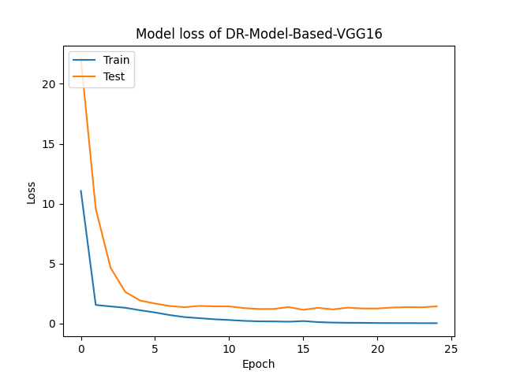
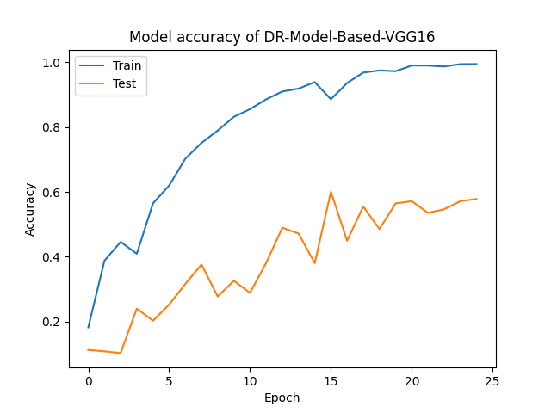
Loss VS Accuracy

Slide 26
Thank You

